Slide 1
Computer Network

Slide 2
Computer Network and the Internet
Chapter 1

Slide 3
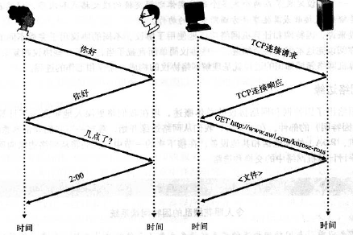
Internet
End System / Host: device connects to the Internet.
Communication Link & Packet Switch: connect hosts.
Packet: Network traffic segmentation.
Internet Standard: IETF-RFC.
API: Application Programming Interface.

Slide 4
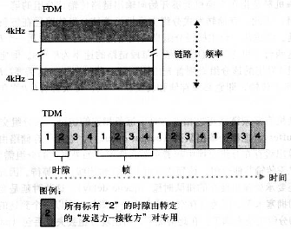
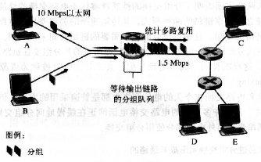
Network Core
Circuit switch & Packet switch.
Frequency-Division Multiplexing FDM
Statistical Multiplexing

Slide 5
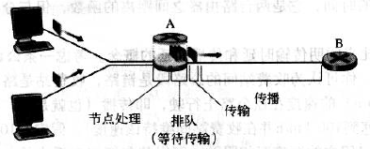
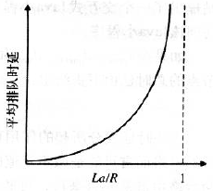
Delay
Delay = nodal processing delay + queuing delay + transmission delay + propagation delay
Packet loss: packet drop.

Slide 6
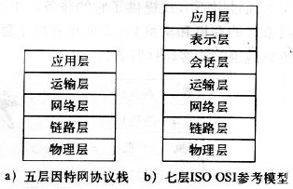
Layer Model
Protocol stack: network layers. ISO-OSI
Application Layer: HTTP, SMTP
Transmission Layer: TCP, UDP
Network Layer: IP

Slide 7
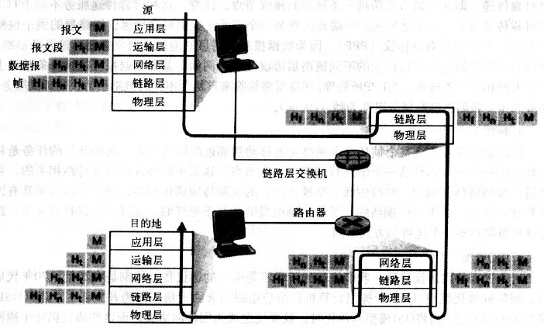
Layer Model

Slide 8
Application Layer: HTTP & DNS
Chapter 2

Slide 9
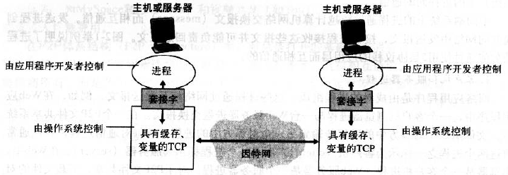
Application – Client and Server

Slide 10

TCP & UDP
TCP:
Reliable data transmission.
Connection Oriented.
UDP:

Slide 11
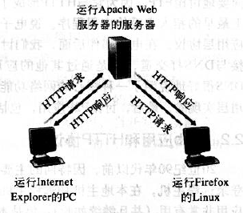
HTTP
Hyper Text Transfer Protocol, HTTP.
Web: objects / elements.
HTTP uses TCP.

Slide 12
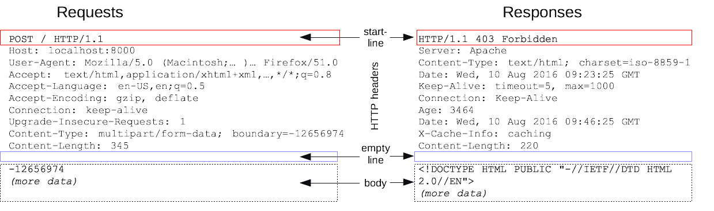
HTTP

Slide 13
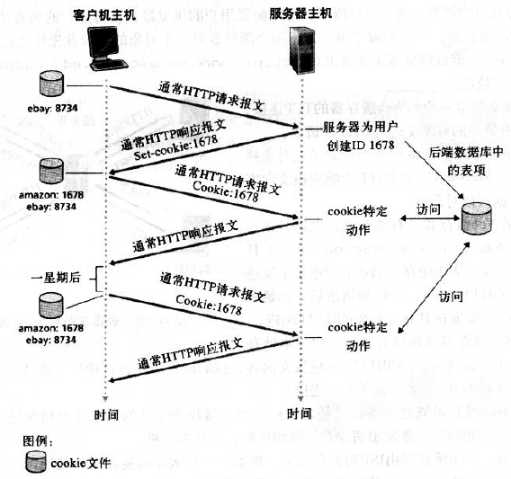
HTTP
Cookie: session control.

Slide 14
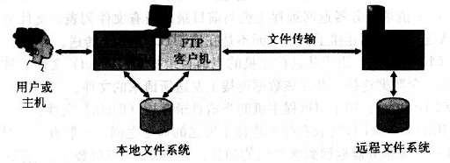
FTP
FTP with 2 parallel TCP connection:
Control connection
Data connection

Slide 15
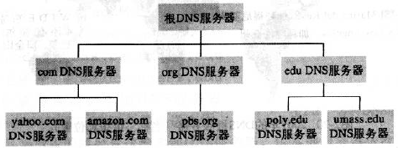
DNS
Domain Name Service, DNS
Host aliasing
Load distribution
DNS cache: local storage DNS record.

Slide 16
Transmission Layer: TCP & UDP
Chapter 3

Slide 17
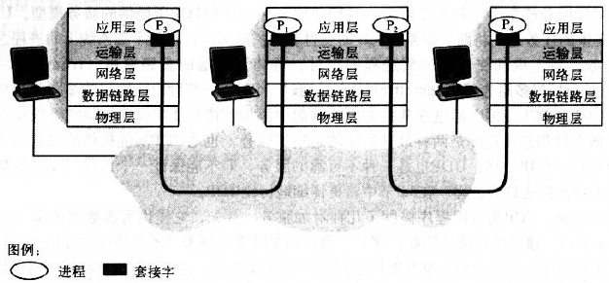
TCP & UDP
IP: unreliable, best-effort delivery service.
Transport layer multiplexing & demultiplexing.
Port: source port & destination port.

Slide 18
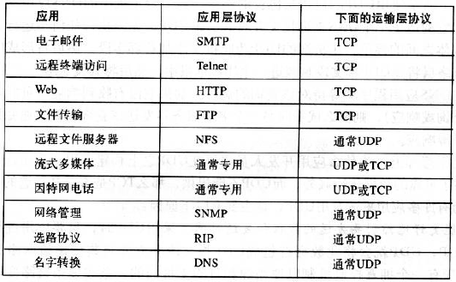
UDP
Better control of data and transmission time.
No connection.
No connection state.
Segment header size small.

Slide 19
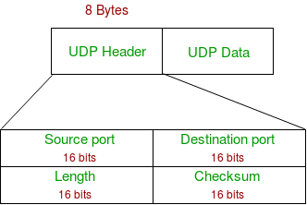
UDP
UDP packet format:
Checksum: sum of data (16bits, backrush) and negative.

Slide 20
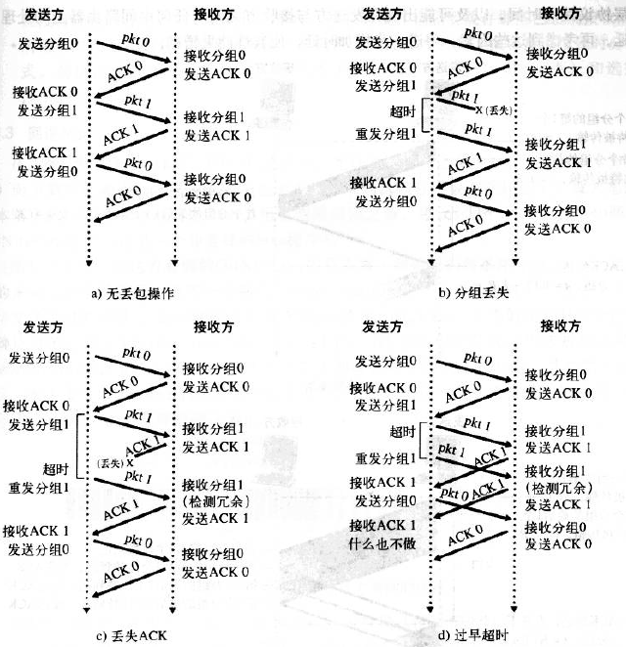
TCP

Slide 21
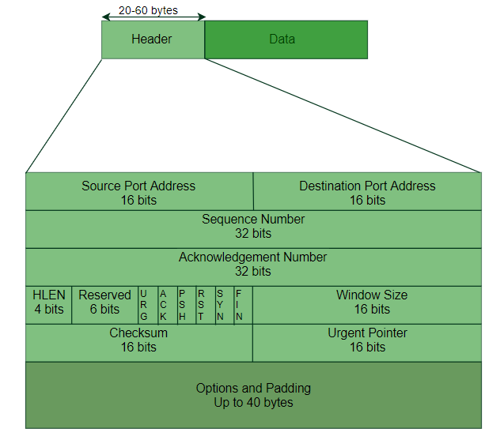
TCP

Slide 22
Network Layer: IP
Chapter 4

Slide 23
Forwarding, Routing
Forwarding: router chooses output link.
Routing: network layer decides path.
Network service model:
Delivery confirm.
Delivery with upper time bound.
Orderly packet delivery.
Minimal traffic width.
Upper delay jitter.
Security service.

Slide 24
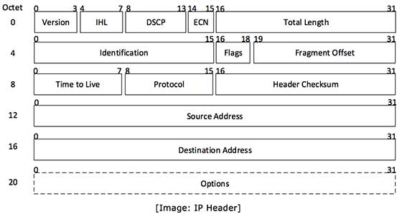
IPv4

Slide 25
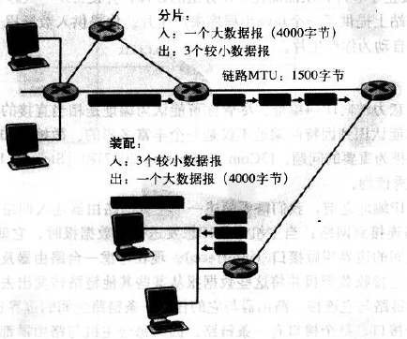
IPv4
IP packet length: smaller than 1500 bytes.
Checksum: similar to UDP checksum.
MTU: Maximum Transmission Unit.

Slide 26
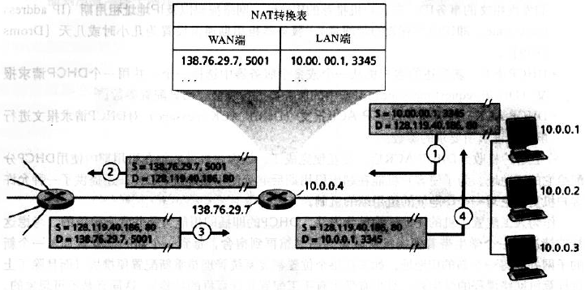
NAT
Network Address Translation, NAT

Slide 27
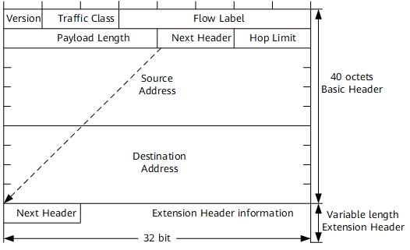
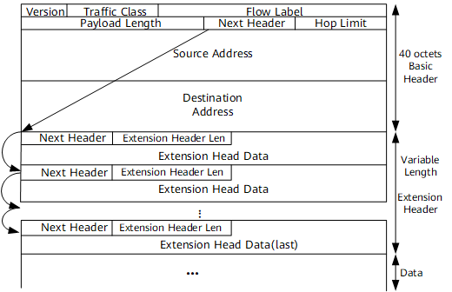
IPv6
Basic headers & extension headers.

Slide 28
Link Layer and LAN
Chapter 5

Slide 29
Link-layer Protocol
Framing: package network layer packet to frame.
Link access: Media Access Control, MAC.
Reliable delivery: used in WiFi.
Flow control: buffer.
Error detection & Error correction.
Half-duplex and full-duplex.

Slide 30
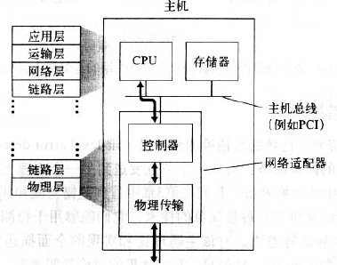
Link-layer
Main part of link layer is in network adapter.

Slide 31
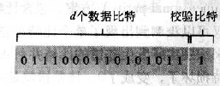
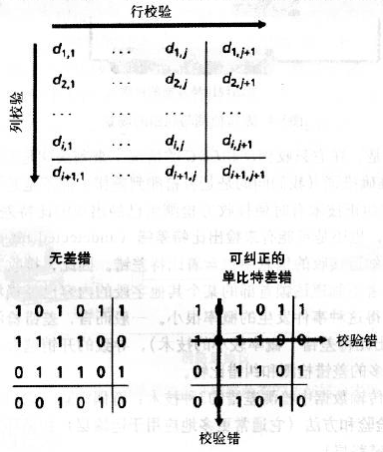
Even-odd Parity
Sum of all bits and even-odd check bit is even.
Two-dimensional parity:

Slide 32
Reference
计算机网络：自顶向下方法
TCP/IP详解：卷一
Wireshark数据包分析实战

